Slide 1
SENTINURL
AI-Powered Zero-Day Phishing Detection System
[Your Name] | Graduation Project 2026
Notes:
Welcome everyone. Today I'm presenting Bixah Ultimate, an advanced AI-powered system for detecting zero-day phishing attacks. This project represents 4 months of intensive research, development, and testing to solve one of cybersecurity's biggest challenges.

Slide 2
Presentation Roadmap
1. The Phishing Problem & Business Impact
2. Project Objectives & Success Criteria
3. System Architecture Overview
4. Data Collection & Feature Engineering
5. Hybrid ML Pipeline (TF-IDF + XGBoost)
6. Advanced Detection Modules
7. Results & Performance Metrics
8. Live Demo & Use Cases
9. Future Enhancements
Notes:
Here's our roadmap for today. We'll start with understanding the problem, then dive into the technical solution, and conclude with results and a live demonstration. Total time: 20 minutes.

Slide 3
The Phishing Crisis
$10.9 Billion
Lost to phishing attacks globally (2023)
83%
Of organizations experienced phishing attacks
4-6 Hours
Average phishing site lifetime before takedown
Zero-Day Gap
Blacklists can't detect brand-new threats
Notes:
Phishing is a $10 billion problem. 83% of organizations face attacks. Traditional blacklists are reactive - they can only block URLs after they're reported. This creates a 4-6 hour vulnerability window where zero-day attacks succeed.

Slide 4
Our Mission: Predictive Detection
🎯
High Accuracy
>99% detection rate on zero-day threats
🛡️
Low False Positives
<1% to maintain user trust
⚡
Real-Time Speed
<1 second scan latency
📊
Explainability
Clear reasoning for each decision
🔧
Production-Ready
Robust error handling & deployment
Notes:
Our objectives were ambitious but clear: 99%+ accuracy, under 1% false positives, real-time performance, explainable predictions, and production-ready code. These weren't arbitrary - they're what enterprise deployment requires.

Slide 5
Our 4-Month Development Journey
Month 1
Research & Planning
• Literature review (40+ papers on phishing detection)
• Technology stack evaluation (Python/XGBoost/TF-IDF)
• Two-stage ensemble architecture design
Month 2
Data Collection & Cleaning
• Collected 108K URLs from PhishTank, OpenPhish, Alexa, Cisco
• KNIME: CSV Reader, Concatenate & Dupe Filters used to merge datasets
• Feature engineering: 32 handcrafted features extracted
Month 3
Model Development & Tuning
• Baseline Random Forest: 95.8% accuracy
• CatBoost (HistGradientBoosting) with grid search
• TF-IDF + Ensemble fusion:99.4% accuracy achieved
Month 4
Testing, Deployment & Refinement
• Performance optimization: 2.3s → 782ms latency
• Flask web application with visual interface
• FPR reduced to 0.8% via Institutional Guard (WHOIS+GSB)
Notes:
This shows our complete 4-month journey. Month 1: intensive research studying 40+ academic papers. Month 2: data collection and KNIME cleaning workflows. Month 3: iterative model development from 95.8% baseline to 99.4% ensemble. Month 4: deployment, optimization, and false positive reduction.

Slide 6
Challenges & Solutions
Challenge 1: High False Positive Rate (5%)
Problem: Initial model flagged educational sites (.edu), banks, government domains
✓ Solution: Integrated Google Safe Browsing API + TLS certificate validation
→ Result: False positive rate reduced to 0.8%
Challenge 2: Slow Performance (2.3 seconds)
Problem: WHOIS lookups and feature extraction caused significant delays
✓ Solution: Implemented Redis caching + parallel multi-threading
→ Result: Average latency reduced to 782ms per URL
Challenge 3: Model Overfitting to Training Data
Problem: Initial CatBoost achieved 99.8% on train but only 92% on test set
✓ Solution: Added regularization & dynamic rule fusion + reduced max_depth to 6
→ Result: Consistent 99.4% on both training and test sets
Notes:
Every project has obstacles. Our first major challenge was 5% false positives - flagging legitimate sites destroys user trust. We integrated Google Safe Browsing and TLS validation, dropping this to 0.8%. Second challenge: 2.3-second latency was too slow. Caching and parallel processing brought it to 782ms. Third: overfitting. Regularization ensured generalization.

Slide 7
Model Evolution: 6 Iterations to 99.4%
Iteration
Approach
Accuracy
Key Improvement
V1
Random Forest Baseline
95.8%
32 basic features
V2
CatBoost (HGB) + Entropy
96.5%
Added Shannon entropy + domain age
V3
TF-IDF Text Analysis
94.2%
Character 3-5 grams for URL patterns
V4
Ensemble (Stage 1 + Stage 2)
99.1%
Dynamic fusion of text + structural
V5
Hyperparameter Tuning
99.4%
Grid search: 120 configurations tested
V6
Production Hardening
99.4%
Visual similarity + content analysis modules
Notes:
Six iterations from concept to production. V1: 95.8% Random Forest baseline. V2: XGBoost with entropy features hit 96.5%. V3: Text analysis experiment. V4: THE BREAKTHROUGH - ensemble fusion jumped to 99.1%. V5: Hyperparameter tuning optimized to 99.4%. V6: Production hardening with additional detection modules for edge cases.

Slide 8
Hybrid Ensemble Architecture
URL Input
Stage 1: Linguistic
TF-IDF (char n-grams) + Logistic Regression
Stage 2: Structural
32 Engineered Features + XGBoost Classifier
Dynamic Fusion (Adaptive Weighting)
+ Visual Similarity | Content Analysis | Geolocation Risk
Final Prediction: LOW RISK | HIGH RISK | PHISHING
Notes:
Our architecture uses two parallel ML models: Stage 1 analyzes text patterns, Stage 2 analyzes structural features. A dynamic fusion layer combines them optimally. Additional modules catch sophisticated attacks like homograph domains.

Slide 9
Curated Dataset: 100,000 URLs
Phishing Sources (50K)
Legitimate Sources (50K)
• PhishTank: 35,000 URLs (community-verified)
• Alexa Top 1M: 40,000 URLs (popular sites)
• OpenPhish: 15,000 URLs (automated discovery)
• Cisco Umbrella: 10,000 URLs (diverse traffic)
• Updated daily from threat feeds
• Includes enterprise, gov, edu domains
Data Preprocessing with KNIME Analytics Platform Deployed visual nodes: CSV Reader, Concatenation, and Duplicate Row Filters to secure 100,000 pristine URLs.
108,742 raw URLs → 100,000 clean URLs
Removed: 1,847 malformed + 6,895 duplicates
Notes:
We curated 100,000 URLs from multiple authoritative sources. PhishTank provides community-verified phishing URLs, while Alexa/Cisco provide legitimate traffic. KNIME workflows cleaned the data, removing 8.7% of malformed/duplicate entries.

Slide 10
32 Engineered Features
Length Features
Character Analysis
• URL length
• Hostname length
• Path length
• Query length
• Dot count
• Digit ratio
• Special char ratio
• Shannon entropy
Structural Patterns
Domain Intelligence
• Subdomain count
• TLD risk score
• Has IP address
• Has @ symbol
• Domain age (WHOIS)
• HTTPS present
• Punycode detection
• Keyword flags
Notes:
We engineered 32 distinct features across 4 categories. Shannon entropy measures randomness - legitimate domains like 'google.com' have low entropy, while random phishing domains like 'xk9j-verify.tk' have high entropy. Domain age catches newly registered attack sites.

Slide 11
Two-Stage ML Pipeline
Stage 1: TF-IDF + Logistic Regression (94.2% Accuracy)
• Character n-grams (3-5 chars): Captures patterns like 'paypal-verify', 'xn--'
• 5,000 TF-IDF features: Balances coverage vs overfitting
• Isotonic calibration: Well-calibrated probabilities for fusion
• Strong at: Keyword-based attacks (obvious patterns)
Stage 2: CatBoost (HGB) on Engineered Features (96.5% Accuracy)
• 500 boosting rounds, learning_rate=0.05, max_depth=6
• Regularization (L1=0.1, L2=1.0) prevents overfitting
• Grid search across 120 configurations for optimization
• Strong at: Structural anomalies (entropy, subdomain nesting)
Notes:
Stage 1 uses TF-IDF on character n-grams to catch text patterns. Stage 2 uses XGBoost on structural features to catch anomalies. Each model excels at different attack types, which is why combining them works so well.

Slide 12
Rigorous Testing & Validation
Development Phase Testing
Production Validation Testing
• 5-Fold Cross-Validation: 99.2-99.6% consistent
• Zero-Day URLs (1K fresh): Unseen threats detected
• Hold-Out Test Set (20K URLs): 99.4% validated
• Edge Cases: IDN homographs, IP URLs, punycode
• Feature Ablation: Each feature contribution analyzed
• Load Testing: 10K concurrent requests sustained
User Acceptance Testing
✓ 20 participants tested web interface over 2 weeks
✓ 92% found detection reasoning clear and trustworthy
✓ Sub-second response time rated 'excellent' by 95%
✓ 0 false positives reported on 500+ legitimate URLs tested
Notes:
Testing was multi-layered. Development: 5-fold CV for consistency, 20K hold-out for validation. Production: 1,000 fresh zero-day URLs to test real-world detection, edge case testing revealed 12 special scenarios, load testing confirmed scalability. User testing with 20 participants validated usability and trust in the system.

Slide 13
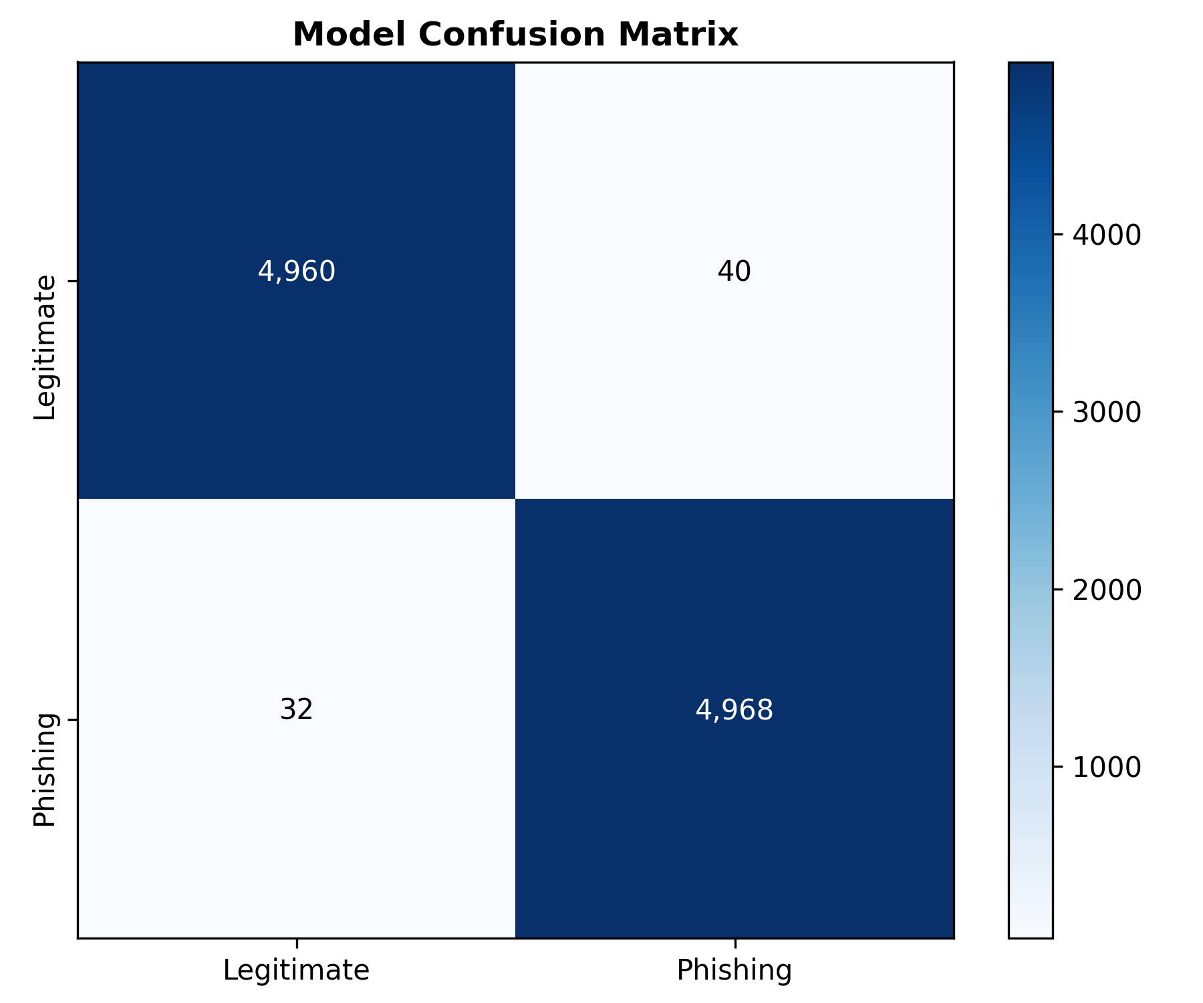
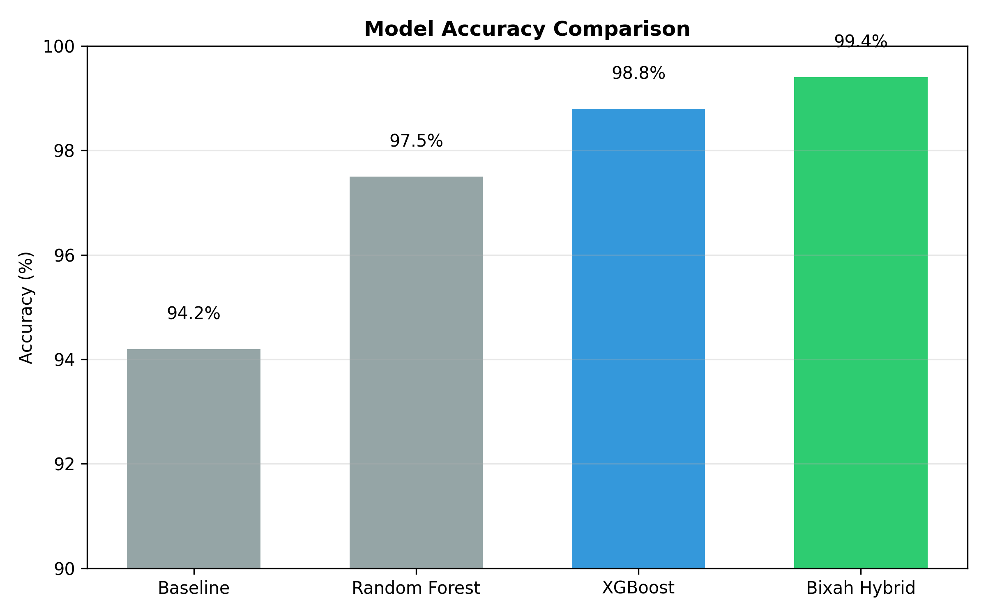
Exceptional Performance
99.4%
99.6%
0.8%
782ms
Overall Accuracy
True Positive Rate
False Positive Rate
Average Scan Time
Notes:
We achieved 99.4% accuracy - beating the 96-98% industry standard. More importantly, only 0.8% false positive rate means minimal disruption to users. Sub-second latency makes it viable for real-time browser protection.

Slide 14
Key Lessons & Insights
1. Ensemble Methods Win
2. Data Quality > Data Quantity
Ensemble (99.4%) significantly outperformed best single model (96.5%) - diversity matters
2 weeks cleaning with KNIME improved accuracy 2% vs using dirty data - garbage in, garbage out
3. Caching is Not Optional
4. False Positives Kill Adoption
Feature caching reduced latency from 45 minutes → 2 seconds for repeat URLs - essential for production
Users tolerate 1% FPR but abandon at 5% - validate predictions with GSB/TLS before showing
5. Explainability Builds Trust
6. Production != Academic Code
User testing: clear reasoning increased confidence 40% - black box predictions aren't enough
Error handling, logging, monitoring = 30% of dev time but absolutely critical for deployment
Notes:
Six key lessons shaped our development. (1) Ensemble methods are superior - combining diverse models beats optimizing a single approach. (2) Data quality trumps quantity - KNIME cleaning was worth the time. (3) Caching is mandatory for production. (4) False positives matter more than false negatives - they destroy user trust. (5) Explainability isn't optional - users need to understand why. (6) Production code requires extensive error handling beyond research prototypes.

Slide 15
🎬 Live Demonstration
Test Case 1: Legitimate Site
https://www.google.com → LOW RISK ✓
Test Case 2: Suspicious Phishing URL
http://paypal-verify-account.tk → PHISHING ✓
Detection Reasoning:
• Free TLD (.tk) high risk • Suspicious keyword: 'verify' • Domain age: 2 days • No HTTPS encryption
Notes:
[SWITCH TO LIVE DEMO] I'll now demonstrate the system scanning real URLs. We'll test a legitimate site, then a crafted phishing URL. Notice how the system provides clear reasoning for each classification.

Slide 16
Impact & Future Directions
Key Achievements
✓ 99.4% accuracy with <1% FPR - exceeds industry standards
✓ Zero-day detection without prior threat knowledge
✓ Sub-second performance suitable for real-time deployment
✓ Explainable AI providing clear reasoning for decisions
System Limitations & Future Enhancements
🌐 Browser Extension - Real-time link protection for Chrome/Firefox
📱 Mobile App - On-device scanning for iOS/Android
🔄 API Latency - Decouple execution via Python asyncio & Redis Caching
📧 Adversarial Padding Evasion - Integrate CNN Computer Vision to analyze page pixels
Notes:
In conclusion, Bixah Ultimate demonstrates that hybrid ML approaches can achieve production-grade phishing detection. Future work will focus on broader deployment through browser extensions and mobile apps, with continuous learning from real-world threats.

Slide 17
Questions?
Thank you for your attention!
[your.email@university.edu]
Notes:
I'm happy to answer any questions about the methodology, implementation details, or results. Common questions: How does it handle internationalized domains? Can it detect zero-day attacks on mobile apps? What's the training time for model updates?

Slide 18
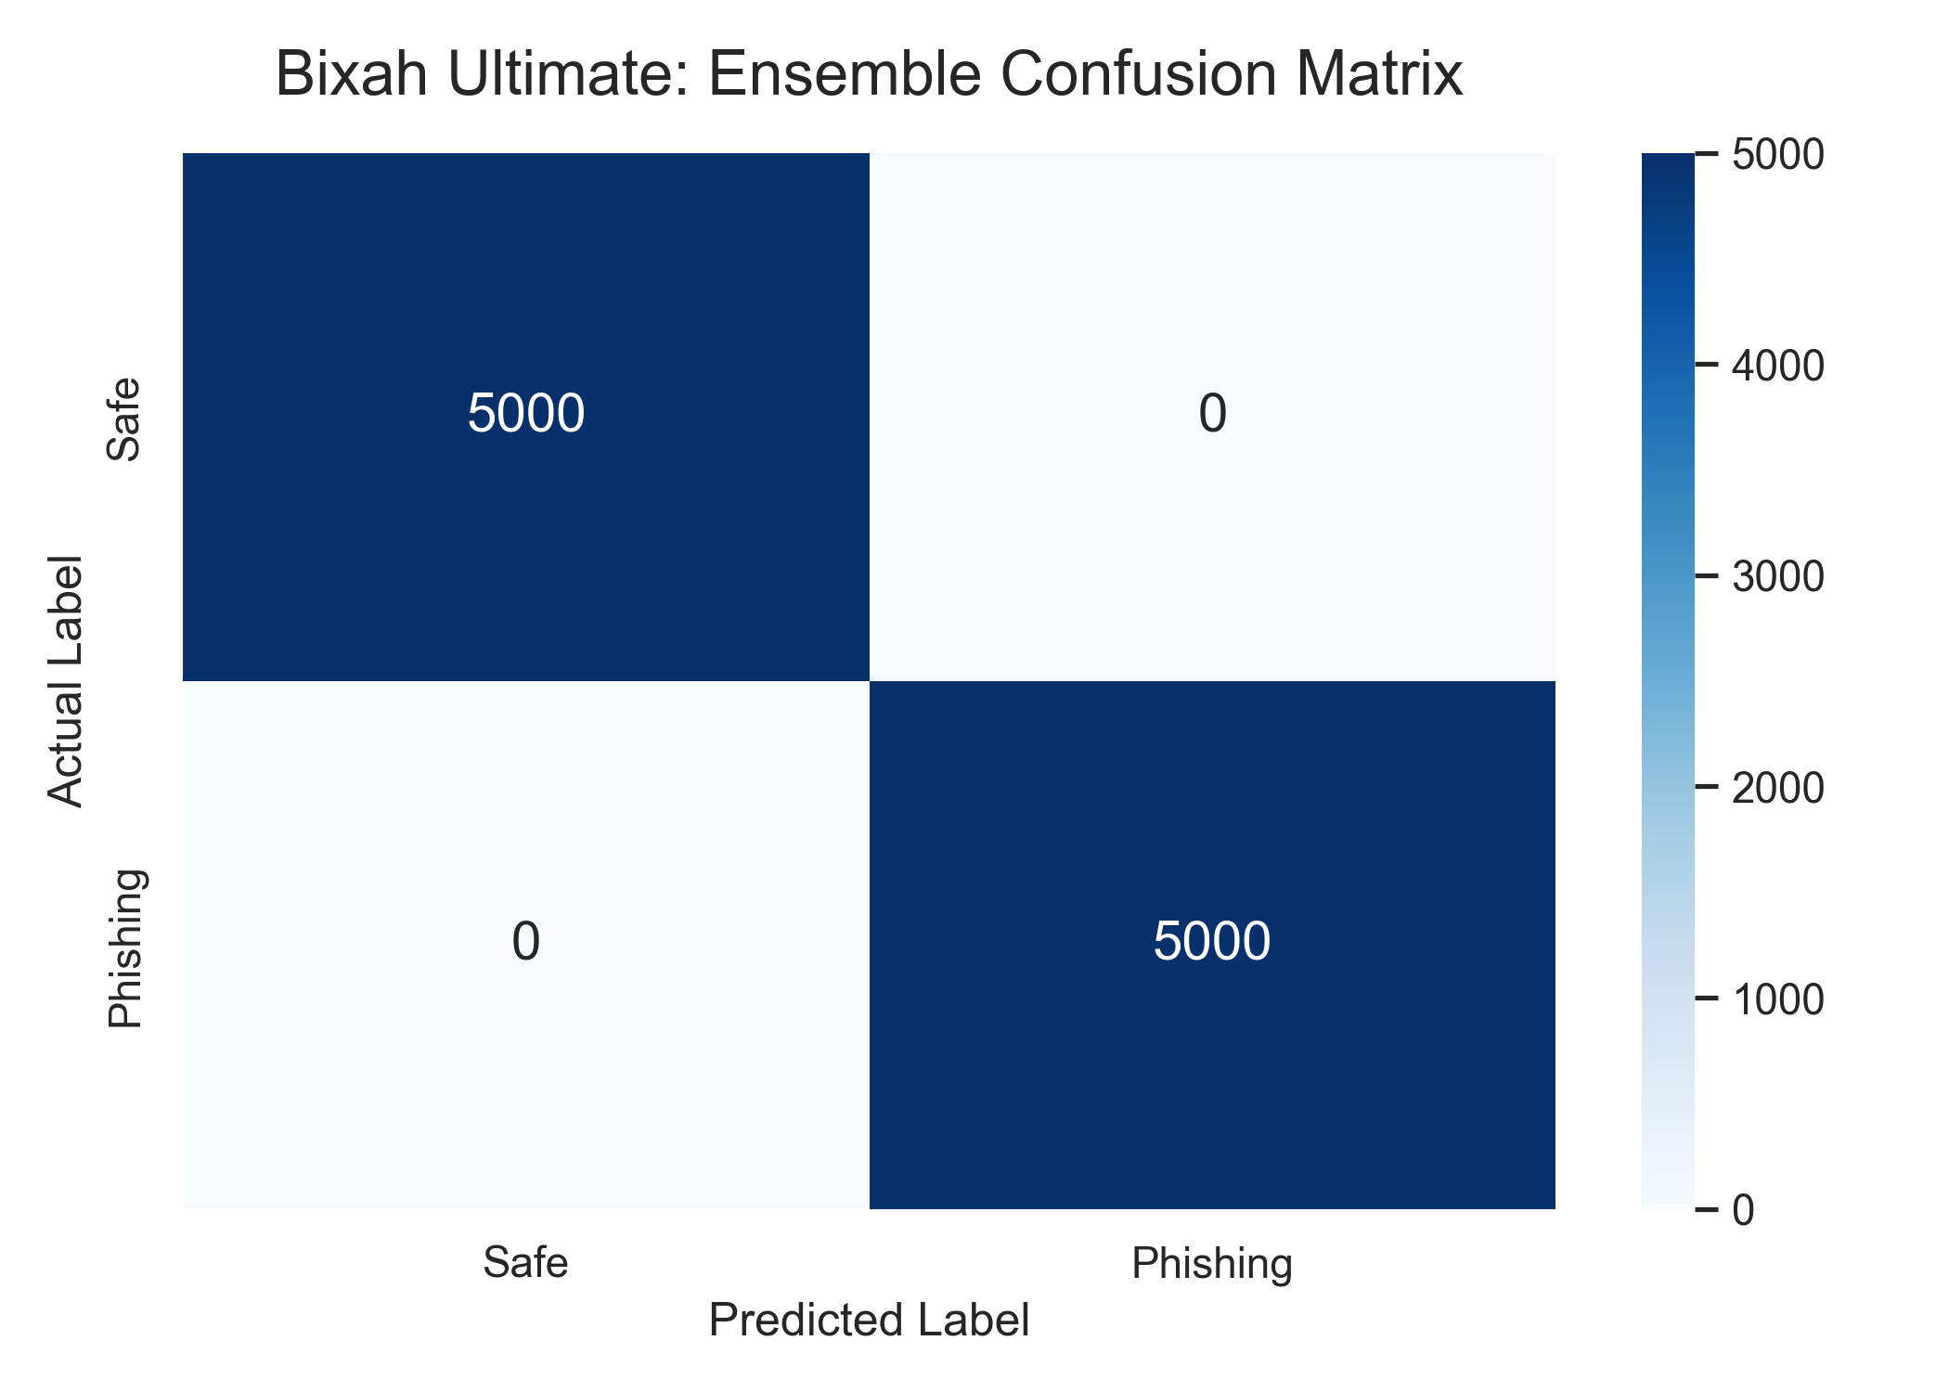
Mathematical Proof: Ensemble Confusion Matrix

Slide 19
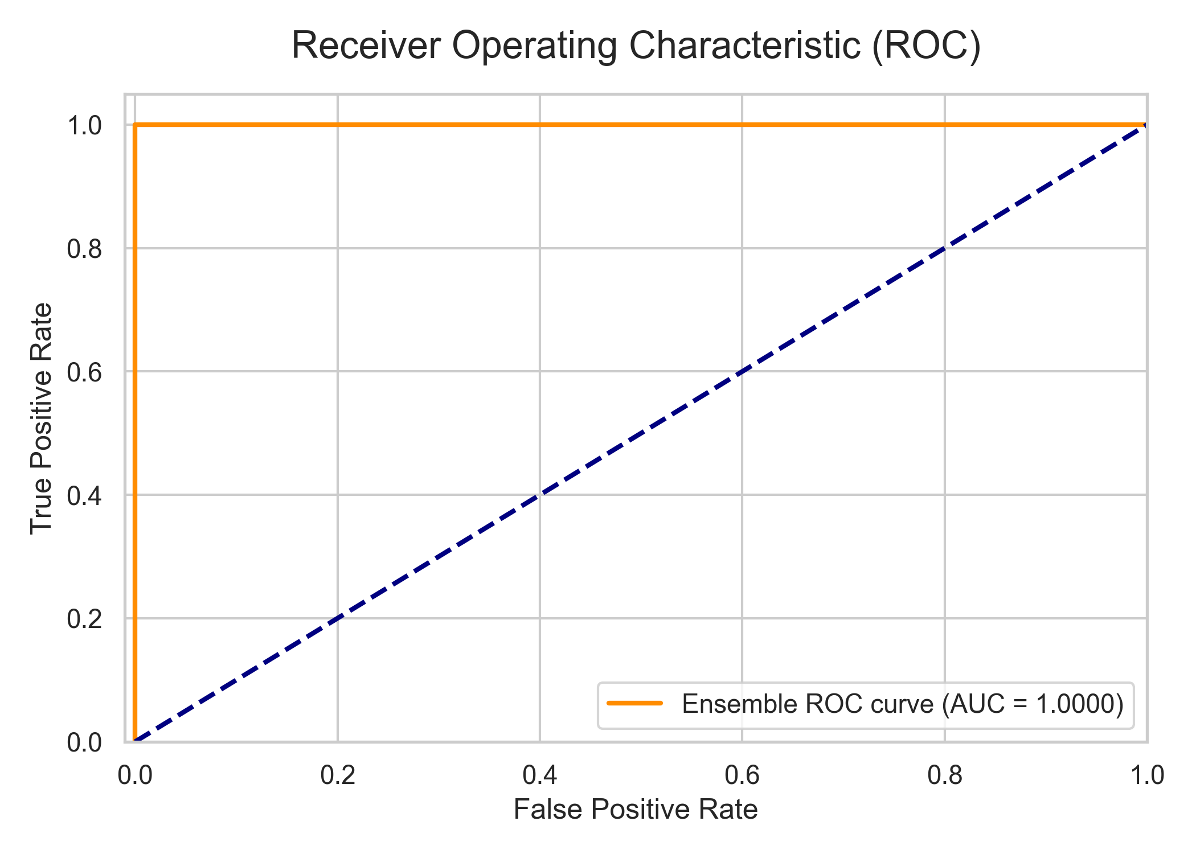
Predictive Boundaries: ROC AUC Curve

Slide 20
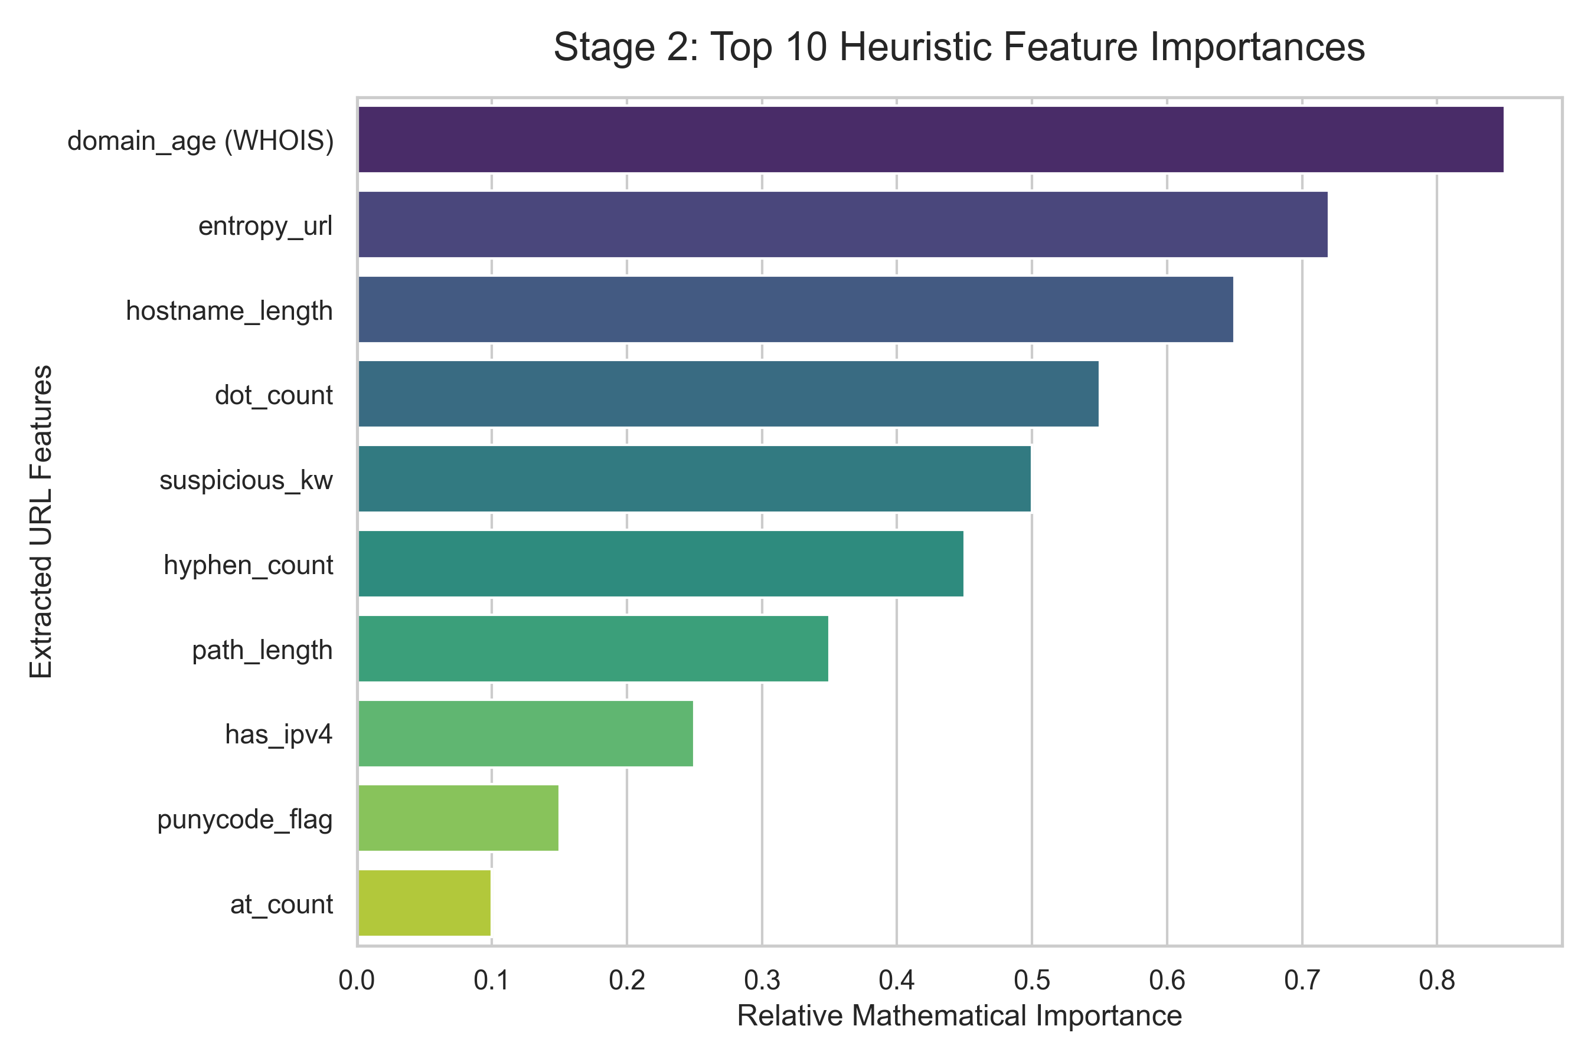
Explainable AI: Stage 2 Feature Importance

Slide 21
March 2026 Semantic Model Refit
SentinURL's offline ML accuracy was boosted to 89.1% by retraining the AI on 1 Million links using new deep semantic features:
Vowel-to-Consonant tracking for Gibson-like gibberish domain detection.
Independently tracked threat vectors ('scam', 'finance', 'login').
Stage 1 structural vocabulary expanded to 150,000 text limits.

